Slide 1

Revenue Details OF EA & ATVI With Chart & Summary
Vinayak Saini

Slide 2
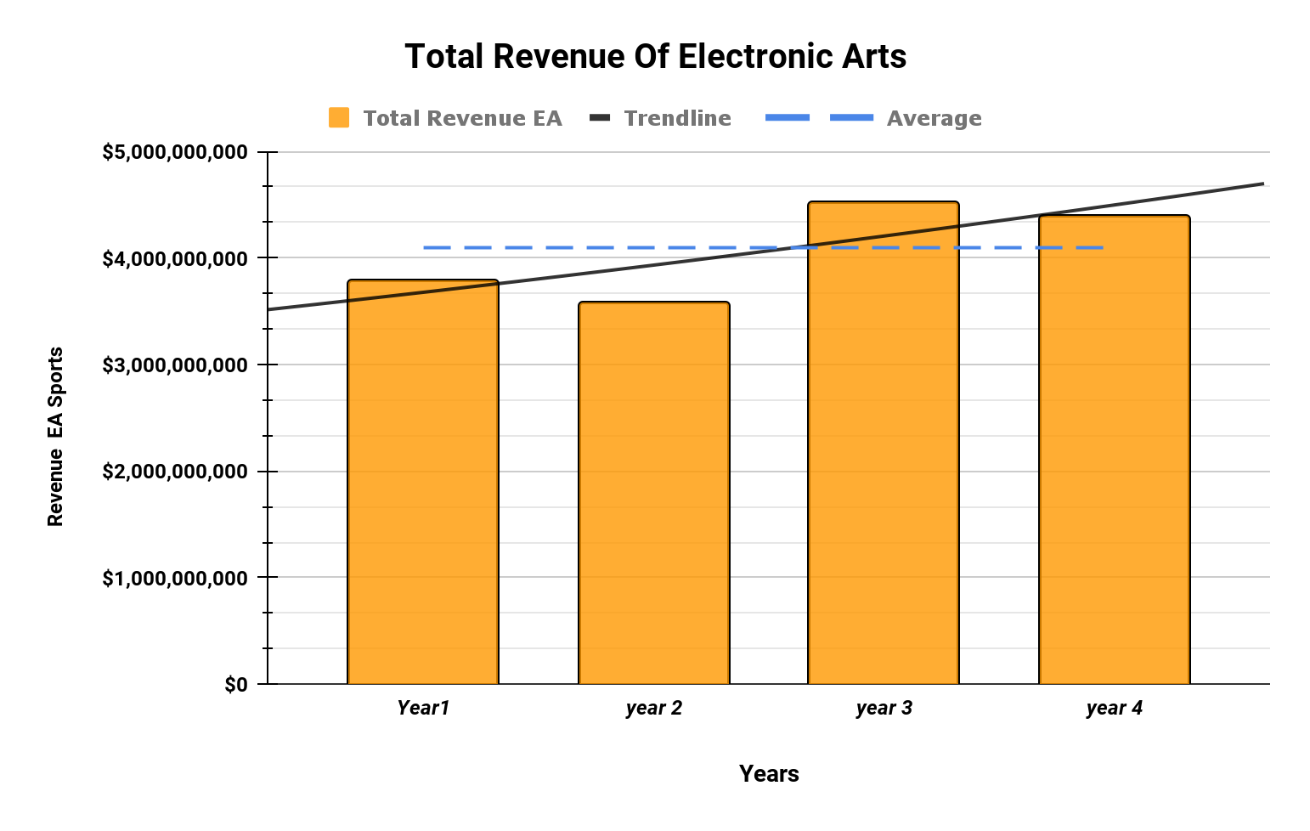
How’s Revenue of EA Games Going over Years? Whats average of it? how is EA performing as Compared to ATVI?
We can see from Chart & trendline that the Revenue of Ea has been progressing as compared to its early years but with slight dips.
The average & median of EA's revenue are approximately same. & we can see 50% of their revenue fall behind average & 50% above. Currently, EA is performing better than previous years. (median $4,096,500,000)
EA Revenue Range is $940,000,000 With Standard deviation of $394,921,749 This Shows EA revenue has more variability as we can also See on Chart Sudden Growth after year 2.
Refer to Linked Gsheet to See Calculation

Slide 3
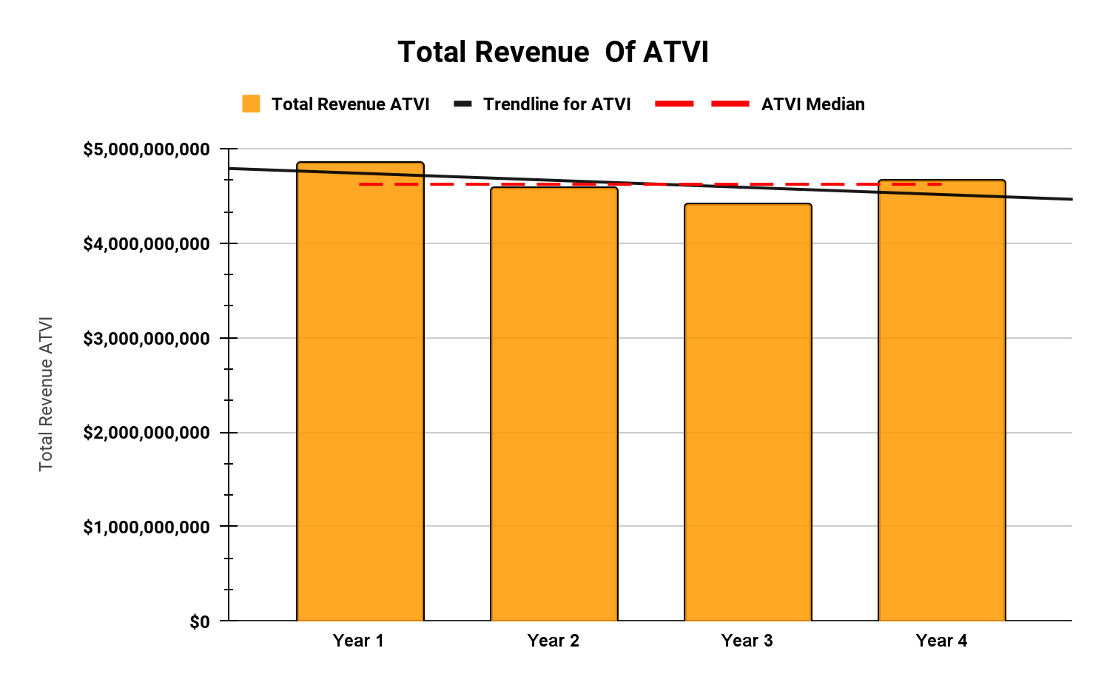
ACTIVISION (ATVI)
The Trendline Shows Signs of Declining growth of ATVI Revenue.
Median & Mean of ATVI are Approximately Same.
We have used Median ($4,096,500,000) As Average and it shows that 50% of ATVI revenue is also Under median. & other 50% Slightly Crossing Median.
Range is $448,000,000 & shows that there is not much Difference B/w lowest & highest revenue of ATVI
&
ATVI STDEV.P is $161,016,109
Showing Less variability as Mostly revenue of ATVI Doesn’t goes too far from Average.

Slide 4
Summary
EA should Analyze how year 3 brought highest revenue & use that tactics in future & learn why they face dips in Year 2 & Year 4 After a certain Growth.
ACTIVISION Should Analyze their Future Plans & Analyze why year 1 brough Highest Revenue & Why They Couldn’t cross or even maintain that revenue level in after year 1.
In Terms of revenue Sure ACTIVISON Has More revenue in the End. But in terms of Growth EA Has better growth of revenue as Compared to ACTIVISON.
EA Has Bigger range $94 Million compared to ATVI $448,000,000 & Bigger STDEV of $394,921,749 than ATVI $161,016,109 That Means EA revenue is More Spread Out and has More variability In summary EA Growth After Year 2 was Consistent and good as Compared to previous year. But incase of ACTIVISON They Started Good But Couldn’t maintain That Pace as result Their Revenue Started to decline.

Slide 5
Link to Gsheet & Note
Link To Project Gsheet
https://docs.google.com/spreadsheets/d/11tiX3jqCewl448lhEYjVyxM2-Q7zpBVsBgYckdG3Uo4/edit?usp=sharing
(All Tabs Are dependent on each other as it takes values from previous tab as Input Also wait a few seconds when changing options from sheets Like Ticker Symbols)
All Task 1-3 are done in Single Gsheet With 4 Tabs.
1st tab = source Data
2nd tab = EA & ATXI Stats & Chart (Task 1)
3rd Tab = Dynamic Profit and Loss Statement (Task 2)
4th Tab = Fianancial Model (Task 3)
Thanks For Your Cooperation 😄

